Slide 1


Slide 2
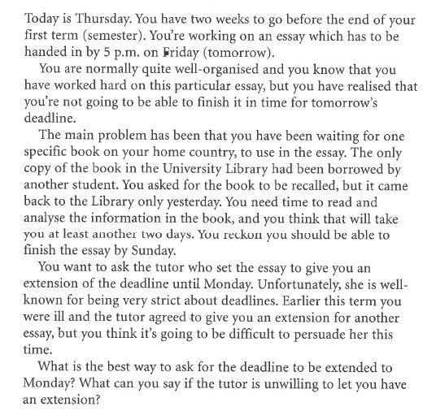
Scenario-1: Deadline for an Essay
Role A Student

Slide 3
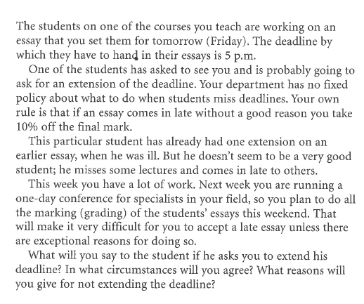
Scenario-1: Deadline for an Essay
Role B Tutor

Slide 4
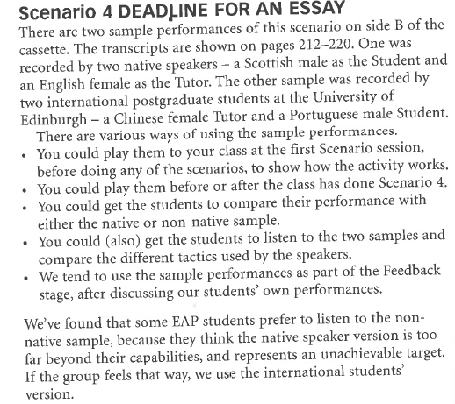

Slide 5
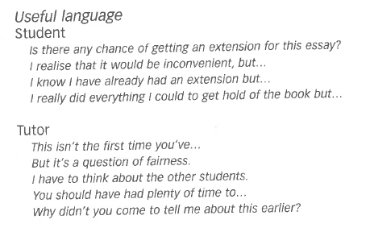

Slide 6
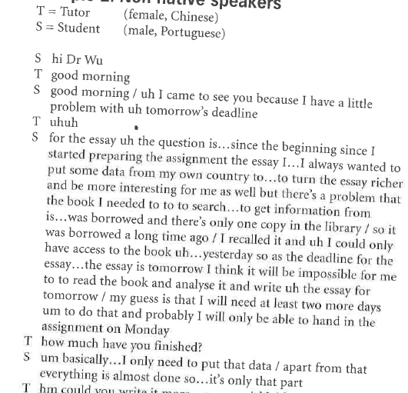
A Model Conversation

Slide 7
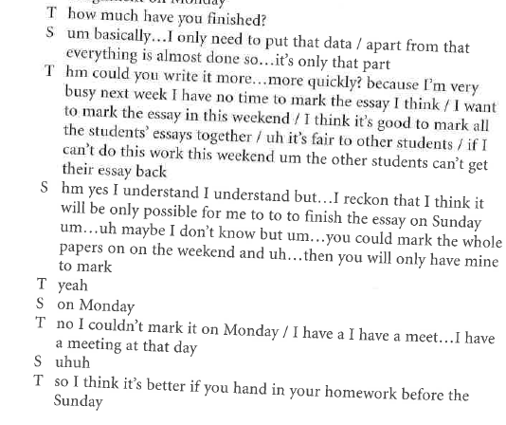

Slide 8
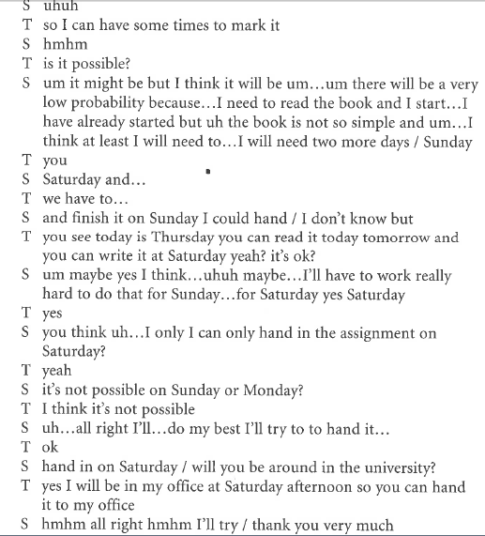

Slide 9


Slide 10
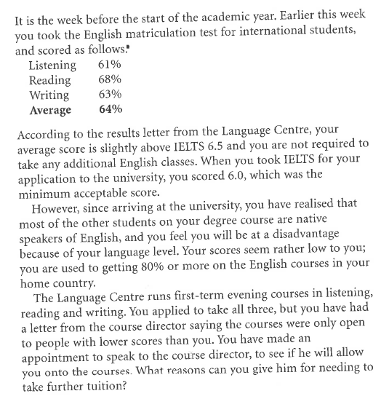
Scenario 2 Language Centre
Role A: Student

Slide 11
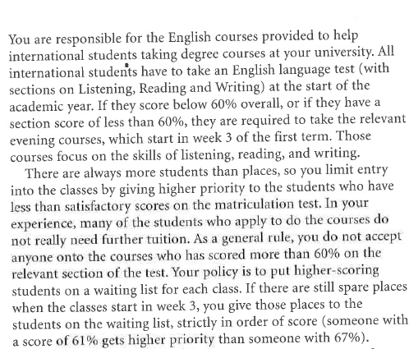
Scenario-2: Language Centre
Role B: Language Course Director

Slide 12
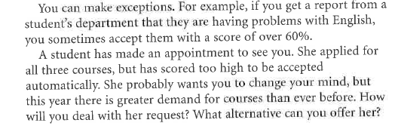

Slide 13
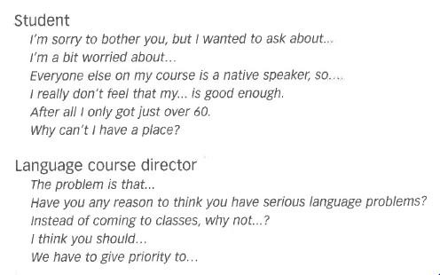
Useful Expressions

Slide 14
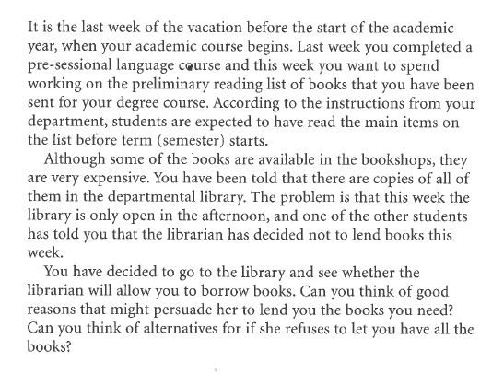
Scenario-3: Library
Role A Student

Slide 15
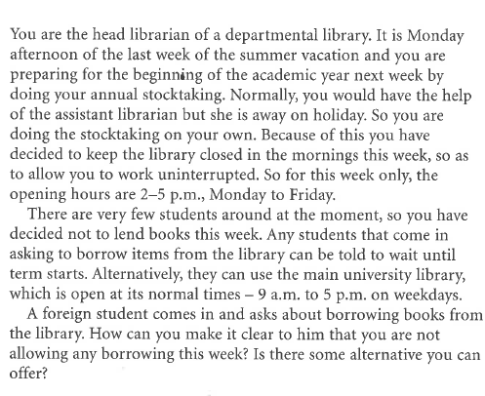
Scenario-3: Library
Role B: Librarian

Slide 16
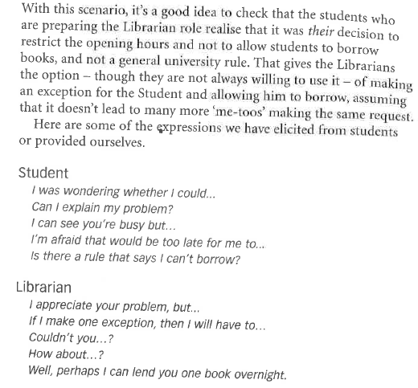
Useful Expressions

Slide 17
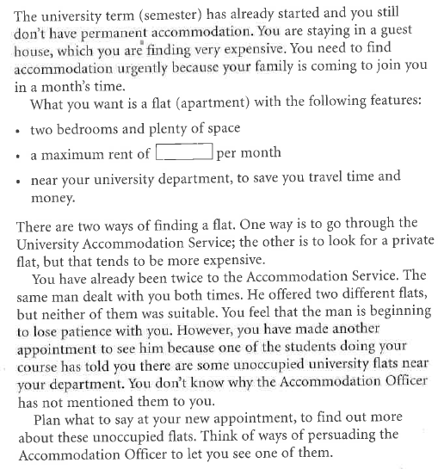
Scenario-4: Finding Accommodation
Role A: Student

Slide 18
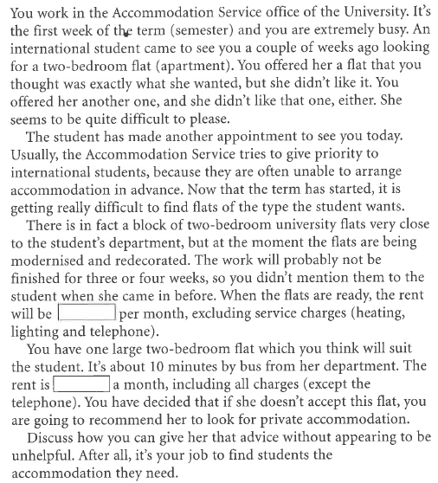
Scenario-4: Finding Accommodation
Role B: Accommodation Officer

Slide 19
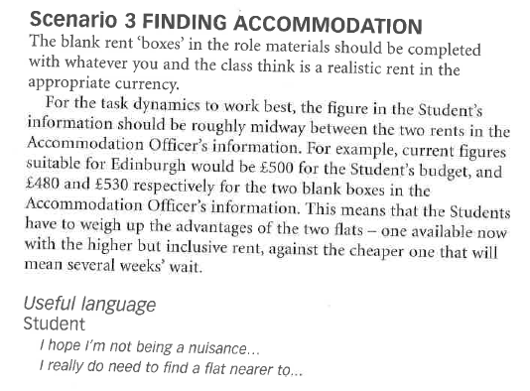
Useful Expression

Slide 20
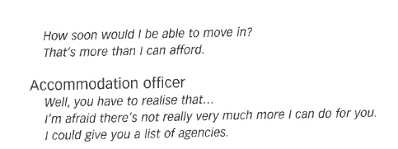

Slide 21
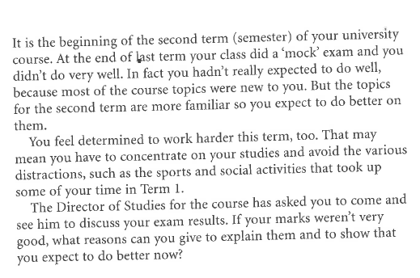
Scenario-5: Examination Results
Role A: Student

Slide 22
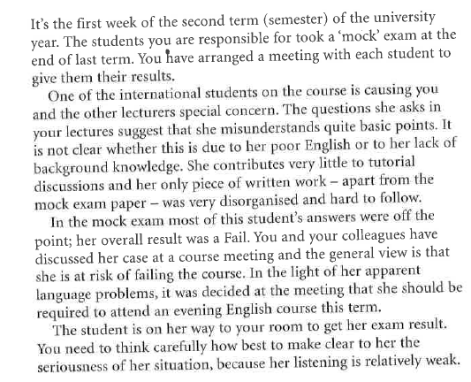
Scenario-5: Examination Results
Role B: Director of Studies

Slide 23
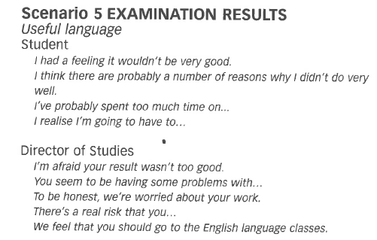

Slide 24
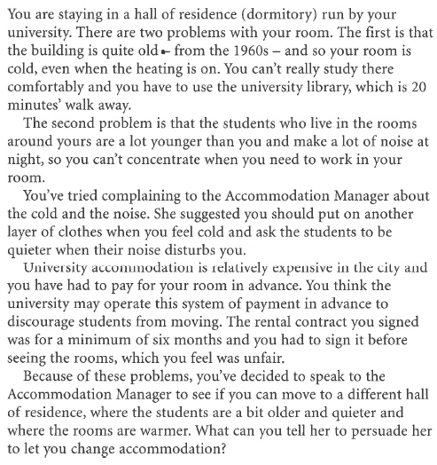
Scenario-6: Changing Accommodation
Role A: Student

Slide 25
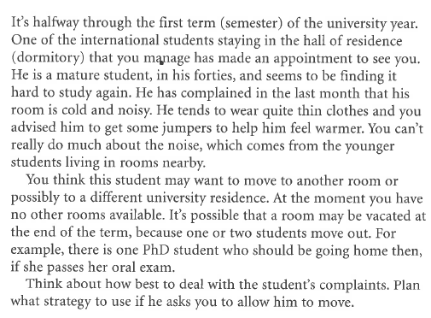
Scenario-6: Changing Accommodation
Role B: Accommodation Manager

Slide 26
